Slide 1
VISUAL FEATURES
THE EXTRACTION OF VISUAL FEATURES INVOLVES TWO PARTS:
1)EXTRACTION OF FACIAL FEATURES
2)EXTRACTION OF SCENE BASED FEATURES

Slide 2

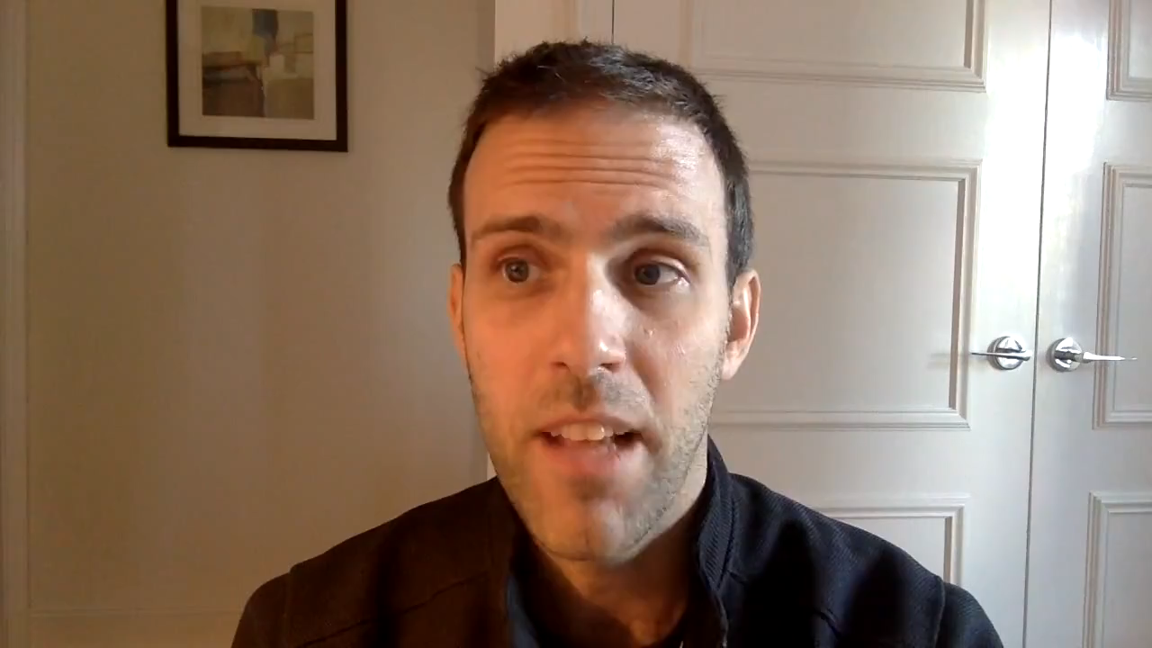
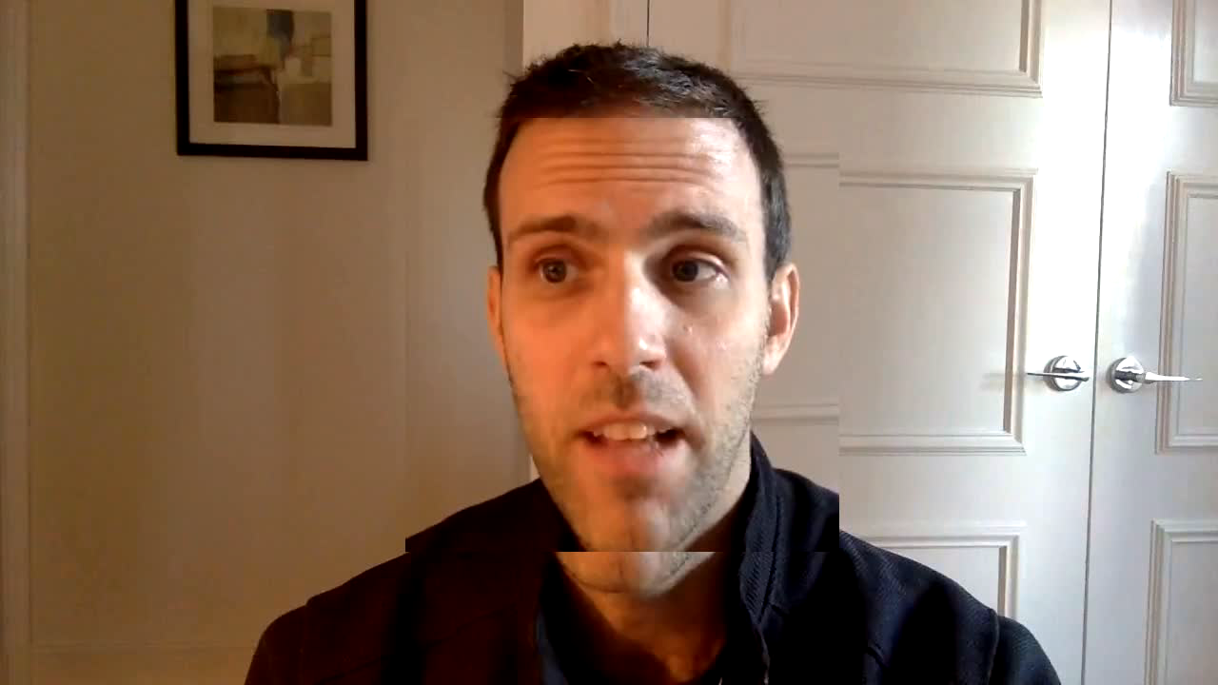
THE FACE ALINGMENT PART WAS CARRIED OUT USING DLIB AND OPEN CV
I USED A 68 LANDMARK DETECTOR FOR THE PURPOSE
Original video
After face alignment

Slide 3

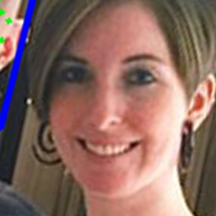
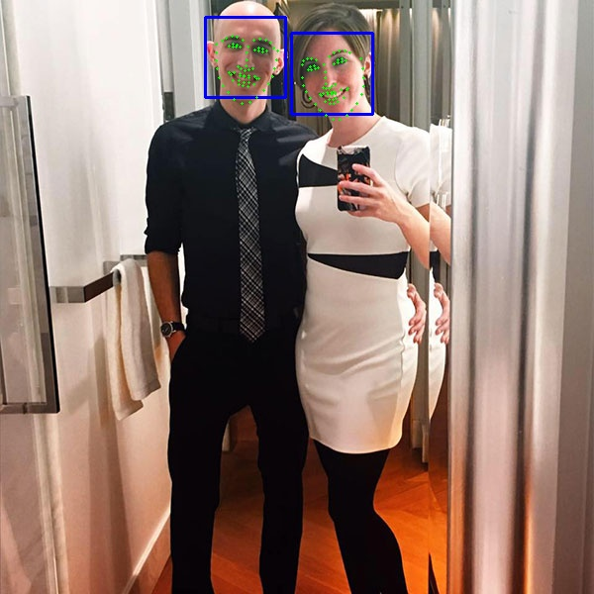

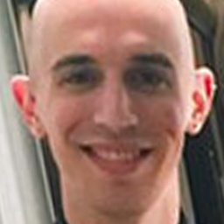
ANOTHER SAMPLE
ORIGINAL
AFTER ALIGNMENT

Slide 4

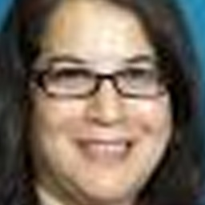
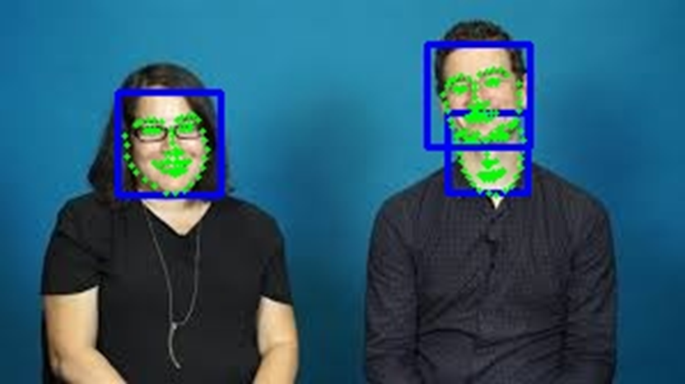
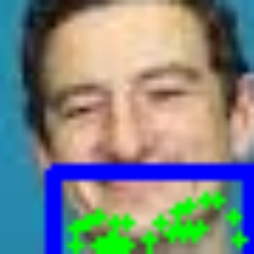
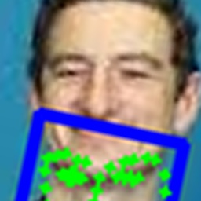
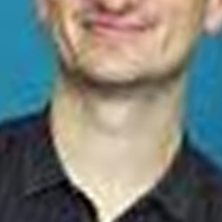

ORIGINAL
ALIGNED
IMAGES WITH WRONG RESULTS

Slide 5
FACIAL FEATURES
Further for the extraction of facial features I was planning to use two models
1) VGG face
2) Local Gabor Binary Patterns(LGBP) descriptor(using 32 Gabor filters )
After that we will combine the model and fed the results into an ELM kernel

Slide 6
SCENE FEATURES
FOR THIS PURPOSE I WAS THINKING TO USE THE VGG 19 OR VGG 16 MODEL

Slide 7
After the evaluation of the five traits we will be using a pre defined set of If else statements for deciding whether to call a person or not

Slide 8
DOUBTS
1)What are free and meta parameters
2) What is the meaning of line ‘Using an LBP descriptor from three orthogonal planes’
3) In the MATLAB code they referred to a word “3d video "so Is it referencing to the original video or something like that

